Slide 1
Logical Database Design

Slide 2
Objectives
Transform an ER model into a relational model.
Create relations for entity and enforce relational integrity constraints.

Slide 3
Logical Database Design
Process of transforming the conceptual data model into a logical data model.
Focus on relational data model.
Most commonly used.
Principles of logical database design for the relational model apply to other logical models.

Slide 4
Components of Relational Model
Data structure
Relations(tables), rows, columns.
Data integrity
Mechanisms for implementing business rules that maintain integrity of manipulated data.
Data manipulation
Powerful SQL operations for retrieving and modifying data.

Slide 5
Relation Recap
Relation
Named, two-dimensional table of data.
Consists of rows (records) and columns (attributes or fields).
Requirements for a table to qualify as a relation:
It must have a unique name.
Every attribute value must be atomic (not multivalued, not composite).
Every row must be unique (can’t have two rows with exactly the same values for all their fields).
Attributes (columns) in tables must have unique names.
The order of the columns must be irrelevant.
The order of the rows must be irrelevant.

Slide 6
Relation Keys
Keys are special fields that serve two main purposes:
Primary keys are identifiers of the relation in question. E.g. employee numbers, social security numbers, etc. This is how we can guarantee that all rows are unique.
Foreign keys are attributes that enable a child relation to refer to its parent relation.
Keys can be simple (a single field) or composite (more than one field)
Notes:
Keys are to databases as identifiers are to E-R models.

Slide 7
Data Integrity Constraints
Entity Integrity
No primary key attribute may be null. All primary key fields MUST have data.
Every relation has a primary key.
Referential Integrity
Rules that maintain consistency among rows of two relations.
Rules state that any foreign key value in the child relation MUST match a primary key value in the parent relation (Or the foreign key can be null) .

Slide 8
Transforming ER Diagrams into Relations
Components of E-R Diagrams
Entity
Attribute
Relationship
Notes:
This is an example of CREATE TABLE statements in SQL. Here we can see how a dependent table references its dominant table through creation of a foreign key.

Slide 9
Correspondence
E-r model
RELATIONAL model
Entities
Entity instances
Attributes
Identifiers
Relationships
Relations
Rows
Columns
Primary keys
Foreign keys
NOTE: The word relation (in relational database) is NOT the same as the word relationship (in E-R model).

Slide 10
Transforming ER Diagrams into Relations
Regular entities
Have an independent existence and generally represent real-world objects, such as persons and products.
Associative entities
Formed from many-to-many relationships between entities.
Notes:
This is an example of CREATE TABLE statements in SQL. Here we can see how a dependent table references its dominant table through creation of a foreign key.

Slide 11
Step 1: Mapping Regular Entities
Name of the entity
Name of the relation.
Identifier of the entity
Primary key of the relation.
Simple attributes
Columns in the relation.
Composite attributes
Use only their simple, component attributes .
Multivalued Attribute
Becomes a separate relation with a foreign key taken from the superior entity.
Notes:
The next several slides show the mechanics of designing relational databases based on E-R and EER data models. As we saw in chapter 1, the database development life cycle often involves first constructing a conceptual model (E-R or EER) and then using this to create the logical model (relational database design). If you do a thorough job of developing the conceptual model, it should be a fairly simple matter to convert this to a well-structured relational database.
However, if you just start by creating tables, you could wind up with a database that is not well-structured, which required you to fix these mistakes. This is the process of normalization, which will be discussed later.

Slide 12

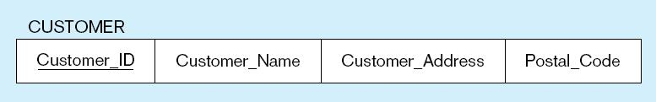
Mapping a Regular Entity
(a) CUSTOMER entity with simple attributes
(b) CUSTOMER relation
Notes:
Very simple. Each attribute of the entity becomes a column (field) of the resulting relation. The identifier of the entity becomes a primary key in the relation.

Slide 13

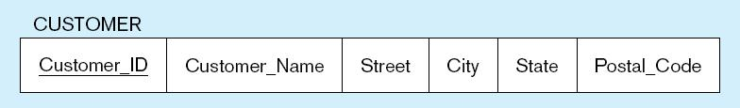
Mapping a Composite Attribute
(a) CUSTOMER entity with composite attribute
(b) CUSTOMER relation with address detail
Notes:
A bit more complex. Although conceptually you can have a composite attribute, there is no such thing as a “composite column” or “composite field” in relational databases. So, the component attributes become individual columns. As you can see, there is no field called “Customer Address” in the relation, just its components.

Slide 14

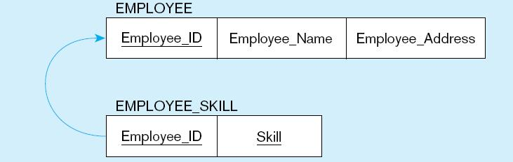
Mapping an entity with a multivalued attribute
(a) Employee with multivalued attribute.
(b) Multivalued attribute becomes a separate relation with foreign key.
One–to–many relationship between original entity and new relation
Notes:
Multivalued attributes in E-R models must be converted to separate relations in the logical database design. This is because there is no such thing as a multivalued attribute in relational databases. Remember the rules for 1st normal form.
In this case, there is a one-to-many relationship in the final database structure. The Employee Skill relation has a composite primary key (EmployeeID and Skill). The EmployeeID portion of this composite primary key is also a foreign key to the Employee table.

Slide 15
Step 2: Mapping Binary Relationships
Cardinalities of the relationship (Maximum Cardinality)
One-to-Many
Primary key on the one side becomes a foreign key on the many side.
Many-to-Many
Create a new relation with the primary keys of the two entities as its primary key.
One-to-One
Primary key on the mandatory side becomes a foreign key on the optional side.
Degree of the relationship
Unary
Binary
Ternary

Slide 16
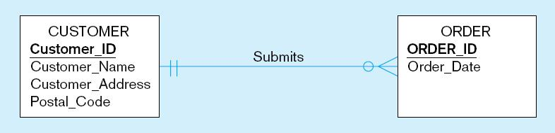
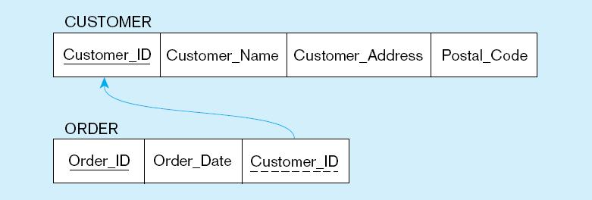
Example of mapping a Binary 1:M relationship
(a) Relationship between customers and orders
Note the mandatory modality
(b) Mapping the relationship
Note: No null constraint on the foreign key…this is because of the mandatory modality.
Foreign key
Notes:
Because of the mandatory one in the relationship, we could have modelled ORDER as a weak entity and Submits as an identifying relationship.
In E-R diagrams, we generally don’t depict the idea of a “foreign key”. This is because the only purpose of a foreign key is to implement the relationship; it is not a meaningful piece of data in itself.

Slide 17
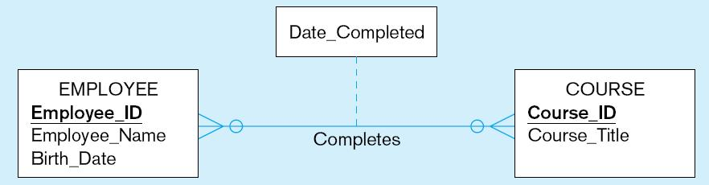
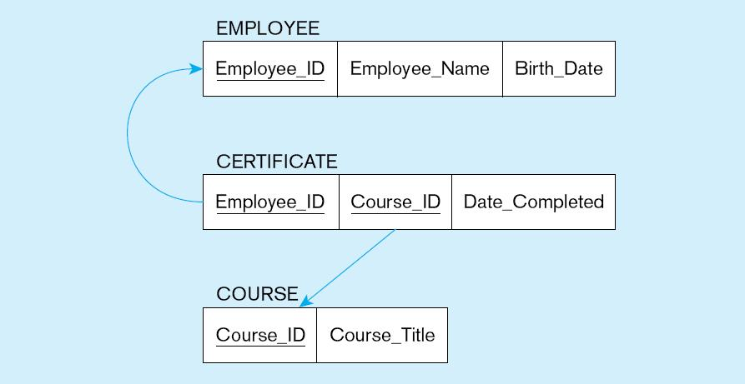
Example of mapping a Binary M:N relationship
a) Completes relationship (M:N)
The Completes relationship will need to become a separate relation
b) Three resulting relations
Foreign
key
Composite primary key
Create New intersection relation
Foreign key

Slide 18
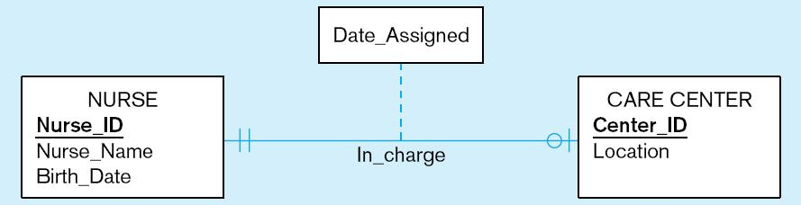
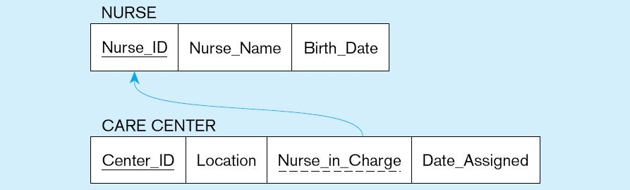
Example of mapping a Binary 1:1 relationship
Special case of 1:M relationship
a) In_charge relationship (1:1)
Often in 1:1 relationships, one direction is optional.
b) Resulting relations
Foreign key goes in the relation on the optional side,
matching the primary key on the mandatory side.
Notes:
Although 1 – to - 1 relationships are less common than 1:N or M:N, they still can occur. This E-R diagram shows that a nurse could be in charge of at most one care center, and that each care center must have exactly one nurse in charge.

Slide 19
Step 3: Mapping Associative Entities
Identifier assigned
Identifier is the primary key.
Identifier not assigned
Default primary key for the associative relation is composed of the primary keys of the two entities (as in M:N relationship).
Notes:
As we saw in chapter 2, M:N relationships can also be modeled as associative entities. Sometimes this is preferable. Associative entities will map onto intersection tables in the resulting logical database design.

Slide 20
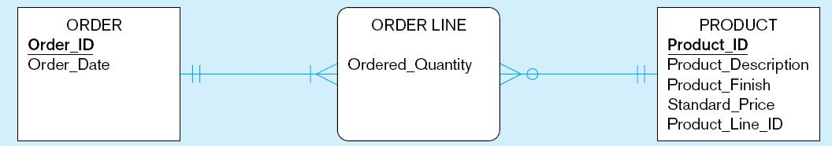
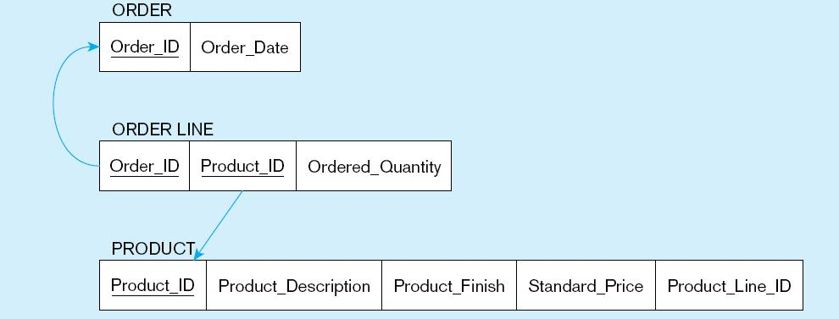
Example of mapping an associative entity
a) An associative entity
b) Three resulting relations
Composite primary key formed from the two foreign keys.
Notes:
In this case, the associative entity has its own identifier…..
Here, Order Line, which implements a M:N relationship between Order and Product, is explicitly modelled as an associative entity.

Slide 21
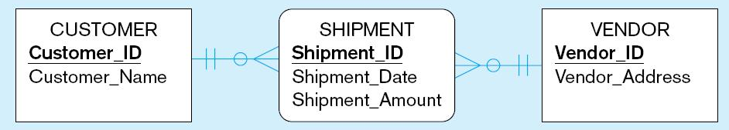
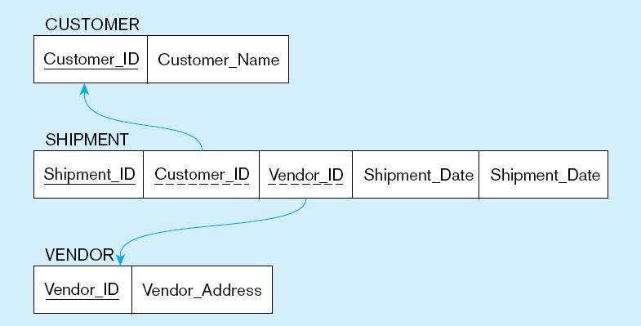
Example of mapping an associative entity with an identifier
a) SHIPMENT associative entity
b) Three resulting relations
Primary key differs from foreign keys.

Slide 22
Step 4: Mapping Unary Relationships
One-to-Many Unary Relationship
Recursive foreign key in the same relation.
Many-to-Many Relationship
Two relations
One for the entity.
One for an associative entity in which the primary key has two attributes, both taken from the primary key of the entity.

Slide 23
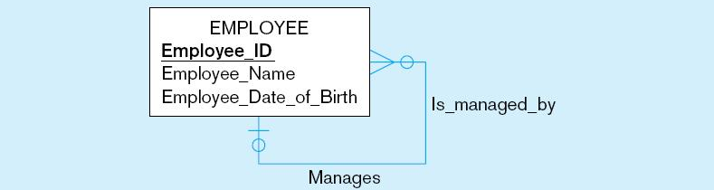
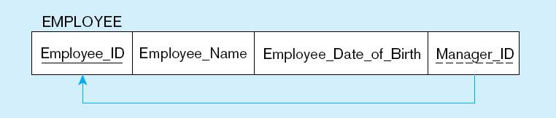
Example of mapping a Unary 1:N relationship
(a) EMPLOYEE entity with unary relationship
(b) EMPLOYEE relation with recursive foreign key
Recursive Foreign Key:
A foreign key in a relation that references the primary key values of that same relation.
Notes:
The E-R diagram involves a one-to-many relationship. Thus, the foreign ley is in the same table as the primary key. This is often called a “recursive” key because it points at records in the same table.
Because of the optional relationship, it is possible for an employee not to have any supervisor. Therefore, the ManagerID field could be null.
This structure is an example of storing hierarchies. It enables the representation of a supervisor who has subordinates, and these subordinates could in turn manage other subordinates, etc.

Slide 24
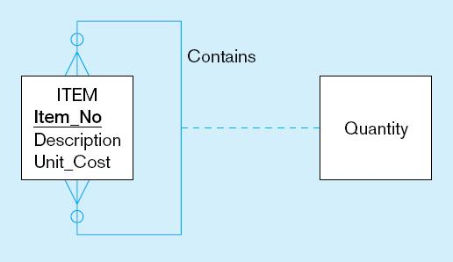
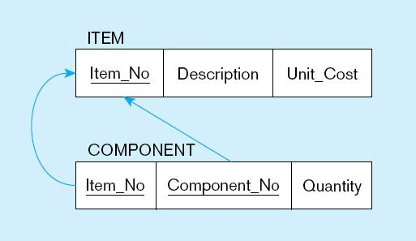
Example of mapping a Unary M:N relationship
(a) Bill-of-materials relationships (M:N)
(b) ITEM and COMPONENT relations
Notes:
As always, any many-to-many relationship requires a separate table (relation).
Bill-of-materials is another classic example of representing hierarchies in a database. An item may have sub-items, which could in turn have other sub-items, etc. However, there is a difference between this and the employees example from earlier. A given employee can have only one direct manager (1:N). But a component could conceivable be part of many other items (M:N).

Slide 25
Step 5: Mapping Ternary (and n-ary) Relationships
One relation for each entity and one for the associative entity.
Associative entity has foreign keys from each entity in the relationship.

Slide 26
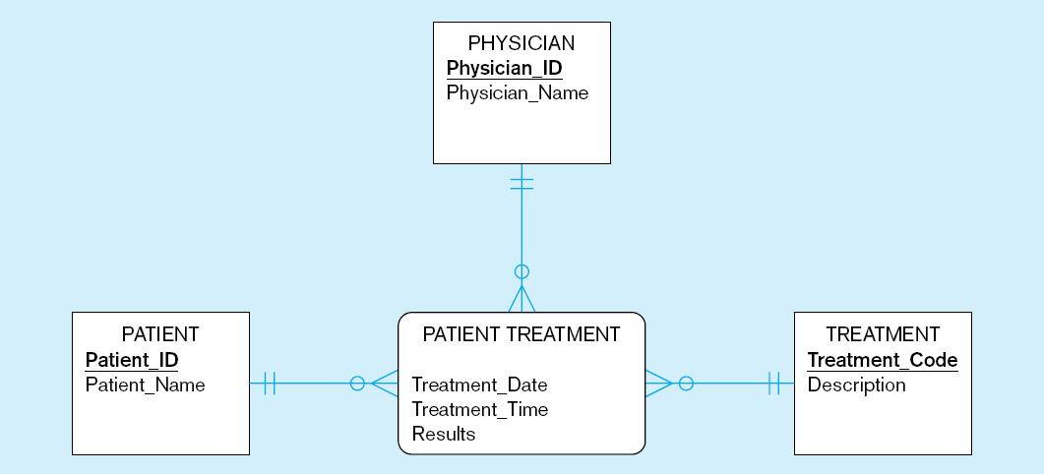
Example of mapping a Ternary relationship
(a) PATIENT TREATMENT Ternary relationship with associative entity
Notes:
Note that this ER diagram shows that a given physician can give a particular treatment to a particular patient, and that this could happen more than once.

Slide 27
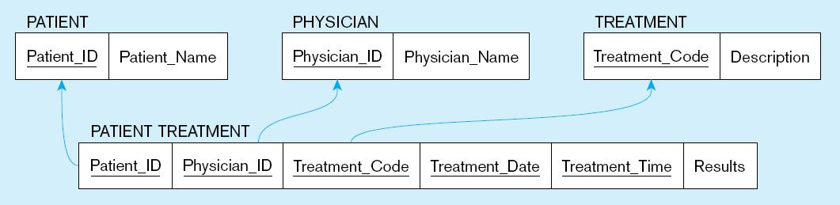
Mapping a ternary relationship (cont.)
b) Mapping the ternary relationship PATIENT TREATMENT
Remember that the primary key MUST be unique.
This is why treatment date and time are included in the composite primary key.
Notes:
This is why the primary key of the Patient Treatment table needs more than just the three foreign keys to Physician, Treatment, and Patient. This is why date and time are part of the primary key. But this creates a primary key consisting of five separate columns.
Suppose later we were to create a table that depends on patient treatment. If we did this, then that table would have a five-field foreign key! Very cumbersome.
So, the solution would be to have a surrogate primary key. If you have large composite primary keys, this is an indicator that a surrogate key is preferable.

Slide 28
Mapping a ternary relationship (cont.)
b) Mapping the ternary relationship PATIENT TREATMENT
Treatment# | Patient_ID | Physician_ID | Treatment_Code | Treatment_Date | Treatment_Time | Results
But this makes a very cumbersome key.
It would be better to create a surrogate key like Treatment#.
Notes:
This is why the primary key of the Patient Treatment table needs more than just the three foreign keys to Physician, Treatment, and Patient. This is why date and time are part of the primary key. But this creates a primary key consisting of five separate columns.
Suppose later we were to create a table that depends on patient treatment. If we did this, then that table would have a five-field foreign key! Very cumbersome.
So, the solution would be to have a surrogate primary key. If you have large composite primary keys, this is an indicator that a surrogate key is preferable.

Slide 29
Modality: Minimum Cardinality
Define it in relationships between tables
Note: all relationships between tables are 1:M
So we just consider the “one” side and the “many” side
Optional or Mandatory?
The “One” Side
Optional: the foreign key on the “many” side can be null
Mandatory: the foreign key on the “many” side cannot be null
The “Many” Side
Optional: the primary key on the “one” side can contain values that are not in the foreign key on the “many” side
Mandatory: all the values in the primary key on the “one” side also exists in the foreign key on the “many” side
Notes:
This is why the primary key of the Patient Treatment table needs more than just the three foreign keys to Physician, Treatment, and Patient. This is why date and time are part of the primary key. But this creates a primary key consisting of five separate columns.
Suppose later we were to create a table that depends on patient treatment. If we did this, then that table would have a five-field foreign key! Very cumbersome.
So, the solution would be to have a surrogate primary key. If you have large composite primary keys, this is an indicator that a surrogate key is preferable.

